Slide 1

UNIT 1- BIODIVERSITY AND ITS CONSERVATION
FEC-7- INTRODUCTION TO ENVIRONMENTAL SCIENCE
DELHI TECHNOLOGICAL UNIVERSITY
Lokesh Godara
23/MC/082

Slide 2
INTRODUCTION
The word biodiversity is a combination of two words: “biological and diversity” and refers to the variety of life on the Earth.
Biodiversity is the degree of variation of life forms within a given species, ecosystem, biome, or an entire planet. Biodiversity is a measure of the health of ecosystems.
The term was first coined by W.G. Rosen in 1985.
Biodiversity is usually considered at three different levels:
The following are different types of biodiversity:
Genetic diversity: variety in the genetic makeup among individuals within a species
Species diversity: variety among the species or distinct types of living organisms found in different habitats of the planet
Ecosystem or ecological diversity: the variety of forests, deserts, grasslands, streams, lakes, oceans, coral reefs, wetlands, and other biological communities.
Functional diversity: biological and chemical processes of functions such as energy flow and matter cycling needed for the survival of species and biological communities

Slide 3
TYPES OF BIODIVERSITY
1. Genetic Diversity: Genetic diversity is the “raw material” that permits species to adjust to a changing world whether these changes are due to natural factors or are caused by human factors.
It refers to the variation at the level of individual genes and provides a mechanism for populations to adapt to their ever-changing environment. Eg: Human beings
2. Species Diversity: Species diversity refers to the different types of living organisms on Earth.
This includes the many types of birds, insects, plants, bacteria, fungi, mammals, and more. Many differing species often live together in communities depending on each other to provide for their needs.
A species can be defined as a group or population of similar organisms that reproduce by interbreeding within the group. Members of a species do not normally reproduce with members of any other species. Members of a specific species possess common characteristics that distinguish them from other species, and this remains constant regardless of geographic location.
3. Ecosystem Diversity: Ecological diversity or ecosystem diversity is the variety of biological communities, such as forests, deserts, grasslands and streams that interact with one another and with their physical and chemical (nonliving) environments. It relates to the different forms of life which are present in any one particular area or site.
It concerns the different species of a particular genus that are present in an ecological community.

Slide 4
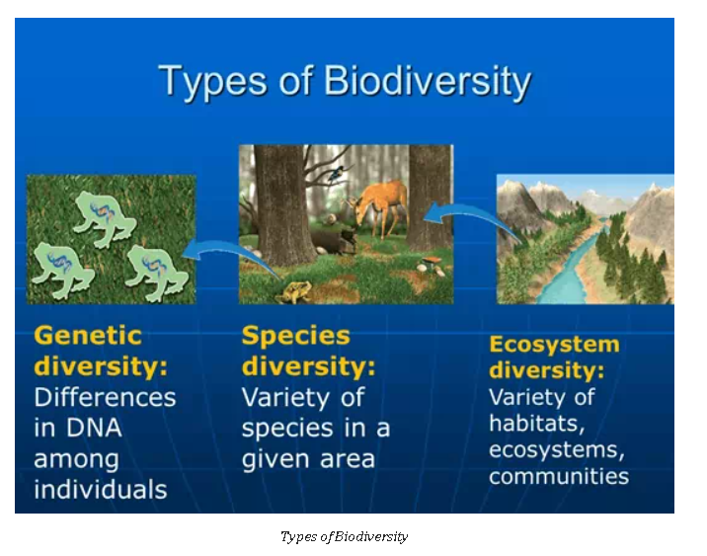

Slide 5
VALUES OF BIODIVERSITY
The value of biodiversity (in terms of its commercial utility, ecological services, social and aesthetic values) is enormous.
1. CONSUMPTIVE VALUE: Biodiversity is an essential requirement for the maintenance of global food supply. The main sources of human food include animals, fish, and plant products.
Many plants are consumed by human beings as food. A few animal species are consumed by people which come including cattle, pigs, sheep, goats, buffaloes, chickens, ducks, geese, and turkey species.
Fish: Many freshwater fish can be grown in ponds. Israel and China already get about half of their fish from aquaculture.
Drugs & medicines: About 75% of the world’s population depends upon plants or plant extracts
for medicines. The drug Penicillin used as an antibiotic is derived from a fungus called Penicillium.
Fuel: Fossil fuels like coal, petroleum products, and natural gas are the products of Biodiversity
2. PRODUCTIVE VALUE: Some of the organisms are commercially usable where the product is marketed and sold.
The animal products like tusks of elephants; musk from deer; silk from silkworms; wool from sheep or goats; and fur of many animals, all of which are traded in the market.
Eg: Calabar bean was traditionally used as a poison in West Africa.
Daisy plants were first used as a lice remedy in the Middle East, leading to the Discovery of Pyrethrum. Mosquito coils made from Pyrethrum are sold in the market.
The bacterium Bacillus thuringiensis produces toxic proteins that kill certain insects

Slide 6
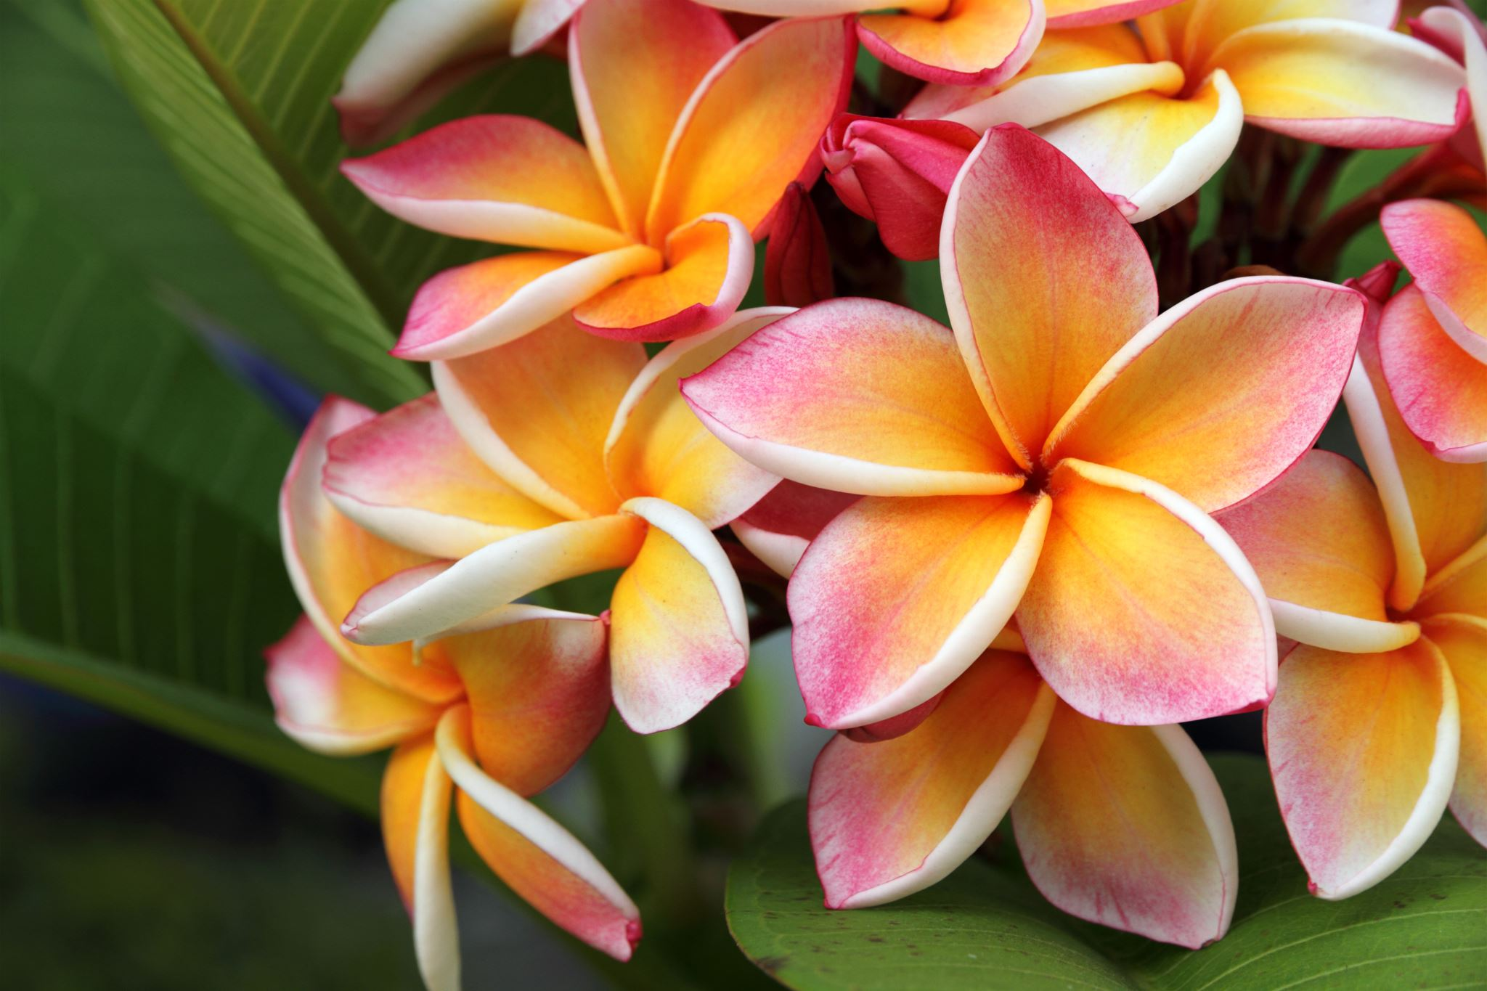
3. SOCIAL VALUE: These are the values associated with the social life, religion, and spiritual aspects of the people. Many of the plants are sacred in our country like Tulasi, Mango leaves, and Banana leaves. The leaves, fruits, and flowers of some of the plants are used in worship.
Many animals like cow, snake, bull, peacock also have significant place in spiritual and thus hold special importance. Thus, biodiversity has distinct social value, attached with different societies.
4. ETHICAL VALUE: The ethical value means that human beings may or may not use a certain species but knowing the very fact that this species exists in nature gives pleasure.
For eg: A peculiar species of Pigeon, grey / white bird with short legs is no more on this earth.
Similarly, Dodo species is also no more. Human beings are not deriving anything direct from Kangaroo, giraffe but strongly feel that these species should exist in nature.
5. AESTHETIC VALUE: Every one of us would like to visit vast stretches of lands to enjoy the visible life. People from farther areas, spend a lot of time and money to visit wildlife areas where they can enjoy the aesthetic value of biodiversity and this type of tourism is known as eco tourism.
Eco-tourism is estimated to generate 12 billion dollars of revenue annually that roughly gives the aesthetic value of biodiversity.

Slide 7
BIODIVERSITY AT GLOBAL, NATIONAL AND LOCAL LEVEL
The enormous diversity of life forms in the biosphere has evolved essentially through the process of trial and error during organic evolution. The changes in the character of living organisms which confer some advantage to the species are retained.
The changes in climatic conditions are reflected in the distribution of living organisms and the pattern of biodiversity on our planet. The number of species present per unit area decreases as we move from mild tropics to the tundras.
The Indian region (8° to 30° N and 60° to 97.5°) with a total area of 329 million hectares is very rich in biodiversity. It is estimated that about 45000 species of plants occur in this country. The position of Indian sub-continent at the confluence of their biogeography reels is also an important contributing factor and explains the preservation of African, European, Sind, Japanese, and Indo-Malayan elements in the flora and fauna in India. It is the sum of such remarkable diversity that has made India a "gene bank" for several food crops, forest trees, medical and aromatic plants, and domesticated animals.
Forests are important bioreserves; most of the 1700 million hectares of tropical forests are in poor countries. There are about 53.5% of tree species found only in these forests and studies of birds, reptiles, primates, and butterflies have revealed equally high or higher endemics.
Countries with diversities higher than India are in South America such as Brazil, and Southeast Asian countries such as Malaysia and Indonesia.

Slide 8
BIOGEOGRAPHIC CLASSIFICATION OF INDIA
Our country can be conveniently divided into ten major regions, based on the geography, climate, and pattern of vegetation seen and the communities of mammals, birds, reptiles, amphibia, insects, and other invertebrates that live in them. Each of these regions contains a variety of ecosystems such as forests, grasslands, lakes, rivers, wetlands, mountains, and hills, which have specific plant and animals.
1. The cold mountainous snow-covered Trans Himalayan region of Ladakh.
2. The Himalayan ranges and valleys of Kashmir, Himachal Pradesh, Uttarakhand, Assam, and other Northeastern States.
3. The Terai, the lowland where the Himalayan rivers flow into the plains.
4. The Gangetic and Brahmaputra plains.
5. The Thar Desert of Rajasthan.
6 . The semi-arid grassland region of the Deccan plateau Gujarat, Maharashtra, Andra Pradesh, Karnataka and Tamil Nadu.
7. The Northeast States of India,
8. The Western Ghats in Maharashtra, Karnataka and Kerala.
9. The Andaman and Nicobar Islands.
10. The long western and eastern coastal belt with sandy beaches, forests and mangroves.

Slide 9
INDIA AS A MEGA DIVERSITY NATION
India contains a great wealth of biodiversity in the forests, wetlands, and marine areas. Hence biodiversity can be observed at all levels i.e. locally, nationally, and globally. India, as a subcontinent representing a major part of South Asia, is rich in flora and fauna and hence it is one of the world’s “MEGADIVERSITY NATIONS”. It is estimated that over 75000 species of animals and over 45000 species of plants are found in India.
Biogeographic regions of India: According to the Wildlife Institute of India, the country has 10 distinct biogeographic zones or regions.
1. Trans – Himalayan Zone
2. Himalayan Zone
3. Desert Zone
4. Semi-arid Zone
5. Western Ghats
6. Deccan Zone
7. Gangetic plain Zone
8. NE Indian Zone 9. Coastal Zone and 10. Islands around the country

Slide 10
HOTSPOTS OF BIODIVERSITY
Areas that exhibit high species richness, as well as high species endemism, are termed hot spots of biodiversity. Species which are restricted only to areas are known as endemic.
India shows a good number of endemic species. About 62% of amphibians and 50% of lizards are endemic to India. Western Ghats are the site of maximum endemism.
The term “Hot spots” was introduced by Myers (1988). There are 36 such hot spots of biodiversity on a global level.
INDIA HAS 4 HOTSPOTS:
Western Ghats: The Western Ghats, a mountain range along the western coast of India, is one of the most biodiverse regions in the country.
It is home to numerous endemic species of plants, animals, and birds.
The Nilgiri Biosphere Reserve, Agasthyamalai Biosphere Reserve, and several national parks like Periyar and Silent Valley are located in this region.
Indo-Burma: The Indo-Burma area, which encompasses sections of northeastern India, Myanmar, Thailand, Laos, Cambodia, and Vietnam, is a biodiversity hotspot.
It is well-known for its diverse amphibians, reptiles, and vegetation. Conservation sites in this region include the Manas National Park and the Namdapha National Park.

Slide 11
The Himalayan Hotspot
The high altitude, pollution-free air, and unique hill soil of the Himalayas support certain plants, animals, insects, and birds that can’t be found elsewhere.
Giant butterflies, brightly colored birds and a variety of deer and goats make up a wonderland that looks like a page out of a coloring book.
Some animals like the snow leopard are moving towards extinction and need to be preserved to maintain the careful balance of nature.
Sundaland
Sundaland is a stretch on the Indian Ocean, including the Nicobar Islands of India.
The hotspot includes the sea floor, teaming with aquatic life.
This hotspot is home to creatures like orangutans, pig-tailed langurs, Javan and Sumatran rhinos, and proboscis monkeys.
Sundaland also has the rafflesia, the largest flowers in the world.

Slide 12
THREATS TO BIODIVERSITY
Edward O. Wilson prefers the acronym HIPPO, standing for habitat destruction, invasive species, pollution, human overpopulation, and over-harvesting.
Habitat destruction
Habitat destruction has played a key role in extinctions, especially related to tropical forest destruction. Factors contributing to habitat loss are overpopulation, deforestation, pollution (air pollution, water pollution, soil contamination), and global warming or climate change.
Habitat loss leads to the loss of habitats of wild animals, their homes, and food sources.
It also leads to disruptions of the ecosystem, reduced genetic diversity, and loss of ecosystem services.
Poaching
Illegal trade of wildlife products by killing prohibited endangered animals
Smuggling of wildlife items like furs, hides, horns, tusks, live specimens, and herbal products worth millions of dollars per year continues, the developing nations in Asia, Latin America, and Africa are the richest source of biodiversity and have an enormous wealth of wildlife.

Slide 13
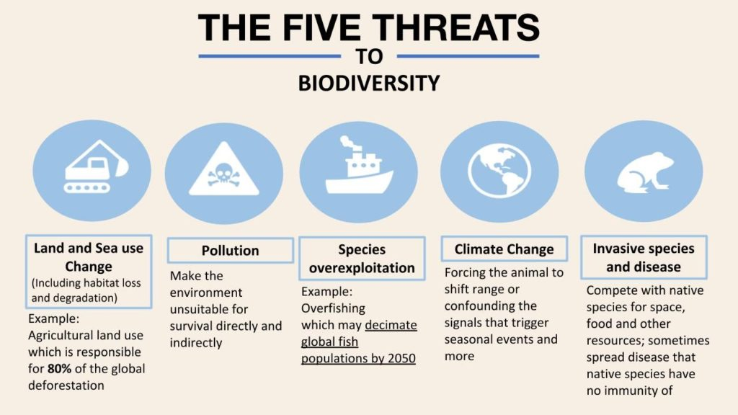
Man-Wildlife Conflicts
Conflicting situations arise when wildlife starts causing immense damage and danger to man and under such conditions it becomes very difficult for the forest department to pacify the affected villages and gain local support for wildlife conservation.
In Sambalpur, Orissa 195 humans were killed in the last 5 years by elephants. In retaliation, the villagers killed 95 elephants in the border region of the Kote-Chamarajanagar belt in Mysore which has been reported recently. The man-elephant conflict in this region has arisen because of massive damage done by the elephants to the farmer’s cotton and sugarcane crops.

Slide 14
ENDANGERED AND ENDEMIC SPECIES OF INDIA
Endangered species A species whose numbers are reduced to the point. That means endangered species are in immediate danger of extinction.
The International Union Conservation of Nature ( IUCN ) classified the species of plants and animals as:
(a) Endangered species
(b) Threatened species: Species ( including animals, plants, fungi, etc.) which are vulnerable to endangerment soon)
(c) Rare species: Among the important endangered animal species, the Indian wild ass; the Golden Langur, etc are considered highly endangered. There are also endangered bird species like the Siberian crane; the great Indian Bustard; the florican etc.
The IUCN published the data on endangered species of both plants and animals of India.
A species is said to be extinct when it is not seen in the wild for 50 years at a stretch e.g., Dodo, Passenger Pigeon.
A species is said to be endangered when its number has been reduced to a critical level or its habitat, have been drastically reduced and if such species is not protected and conserved, it is in immediate danger of extinction.
The International Union for Conservation of Nature and Natural Resources(IUCN) publishes the
Red Data Book which includes the list of endangered species of plants and animals.

Slide 15
The animals that are listed under the critically endangered category are as under:
1)Malabar Large Spotted Civet
2)Namdapha Flying Squirrel
3)Salim Ali’s Fruit Bat
4)Sumatran Rhinoceros
Endangered Species are:
1)Asiatic Lion
2)Asiatic Black Bear
3)Desert Cat
4)Great Indian Rhinoceros
5)Indian Elephant(or)Asian Elephant
Threatened Species are :
1)Indian Wild Ass
2)Leopard
Endemic species of India: Endemic species are those taxa whose distribution is confined to a restricted area due to their specific ecological niches and edaphic gradients. Therefore, the habitats of endemic species are far more vulnerable than other species. Endemic species once lost, it is a loss of biodiversity of these species forever.
In India there are about 5725 endemic taxa of angiosperms (33.5% of Indian flora) which are in 25 hot spots. The major hotspots in India that contain the largest number of endemic plant species are the Southern Western Ghats and Eastern Himalayas with 1286 and 1808 endemic species respectively.
There are about 1272 species of endemic angiosperms out of 3800 species occurring in Kerala (33.5% of Kerala flora) which represent 22.6% of Indian endemics.
Seventy percent of the 1272 species of endemics have the major areas of distribution in Kerala with spillover in adjacent regions
102 endemic species occur exclusively in Kerala.
A large number out of a total of 81,000 animals in our country is endemic. The Western Ghats are particularly rich in amphibians (frogs, toads etc) and reptiles (lizards, crocodiles etc) about 62% of amphibians and 50% of lizards are endemic to the Western Ghats

Slide 16
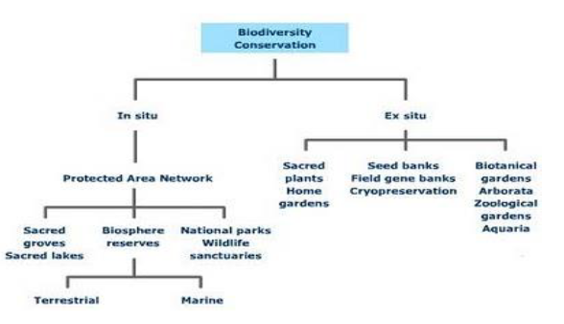
CONSERVATION OF BIODIVERSITY

Slide 17
IN-SITU
When the conservation of the species is done in the natural habitat and environment.
This is also known as on-site conservation.
Eg: Biosphere Reserves, National Parks, Wildlife sanctuaries, Sacred Groves, Biodiversity hotspots.
EX-SITU
When the conservation of the species is done in the artificial environment.
This is also known as off-site conservation.
Eg: zoological garden, botanical garden, seed bank, gene banks, germplasm bank, etc.

Slide 18
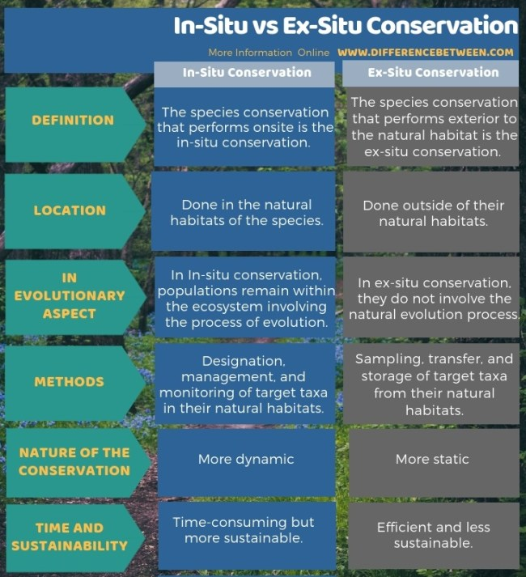

Slide 19
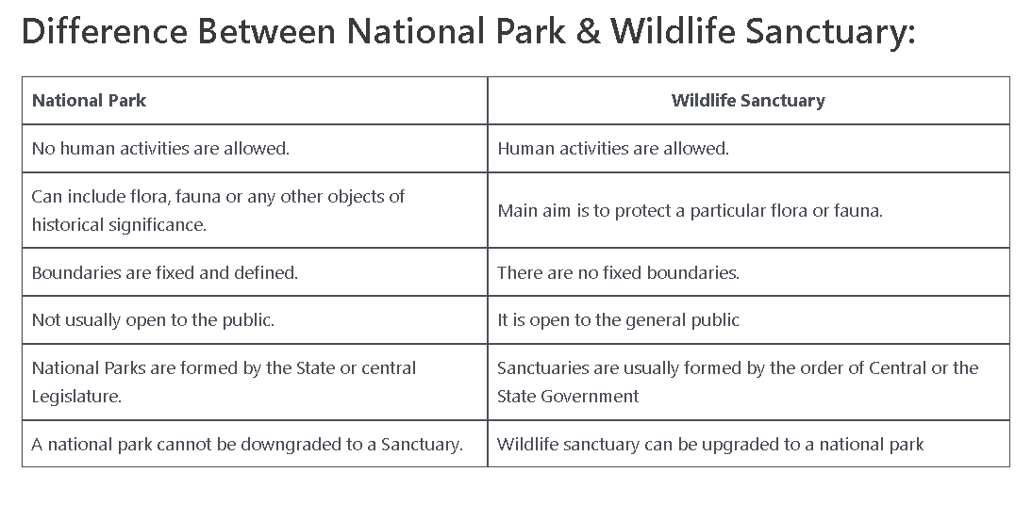

Slide 20

THANK YOU……..
Lokesh Godara
23/MC/082

